Slide 1

Hacktivism
红
客
A Theoretical and Empirical Exploration of China’s Cyber Warriors
Craig Webber & Michael Yip

Slide 2


Hacktivism
Hacktivism: hacking + political activism (Denning 2001)
Wikileaks and Anonymous
LulzSec; Laughing at your security since 2011
Lack of academic research on the “why”

Slide 3



Anonymous, V for Vendetta (1982-1985) and Guy Fawkes (1604): The Power of an Image

Slide 4
Alan Moore
When the creators of V thought about the image and chose Guy Fawkes it was during a series of anti-Thatcher protests. No masks were available for reference, despite their common occurrence in the Autumn, and Guy Fawkes night was replaced with Bonfire night.
"It turns protests into performances. The mask is very operatic; it creates a sense of romance and drama. I mean, protesting, protest marches, they can be very demanding, very gruelling. They can be quite dismal. They're things that have to be done, but that doesn't necessarily mean that they're tremendously enjoyable – whereas actually, they should be.“
http://www.guardian.co.uk/books/2011/nov/27/alan-moore-v-vendetta-mask-protest?INTCMP=SRCH
Case Study: This lecture explores the emergence of “freelance” Chinese hacktivism

Slide 5
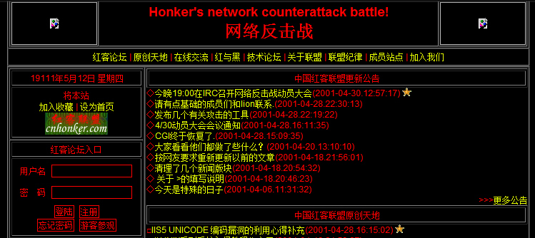
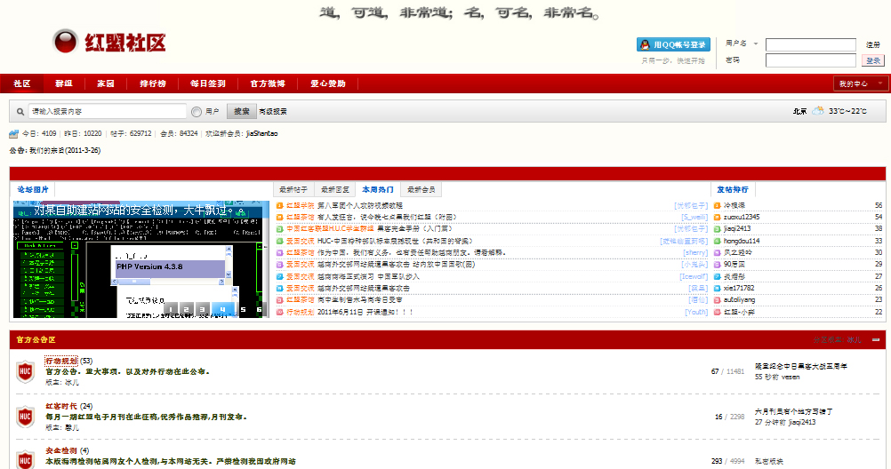
Honkers – “Red Hackers”
Forums are used to:
organise attacks
attract public support
attract volunteers
offer free technical training to gain loyalty
Notes:
Forums are the main communication tool for Chinese activists. In china, this is tolerated, easy to be surveilled but allowed. Demonstrates Chinese State tolerance.

Slide 6
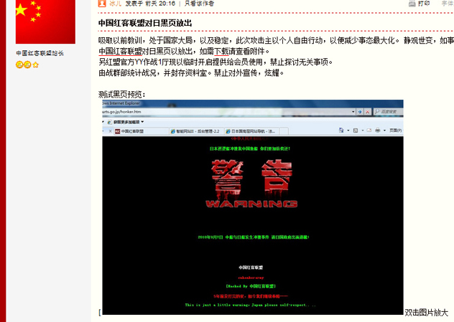
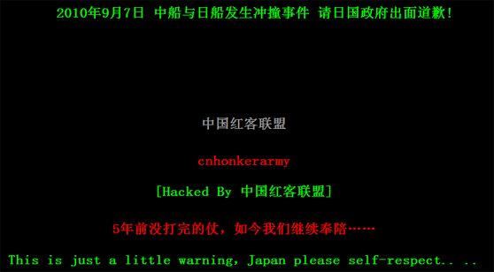
Hackvitist groups deface websites and display their results on their forums
Symbolic targets and high profile attacks preferred to seek public support
Defaced websites are often left with a message

Slide 7
Theoretical Framework
R.D. is a sense of deprivation and not necessarily an objectively measurable entity (Runciman 1966).
Proposed by Tajfel and Wilkes (1963) that ingroup members need to positively distinguish themselves from an outgroup and this is enough to cause conflict.
Relative Deprivation
Chinese Nationalism and Humiliation
ressentiment
Social Identity Theory
Chinese nationalism
is not just about celebrating the glories of Chinese civilization; it also commemorates China’s weakness. (Callahan 2004)
Following Nietzsche and Max Scheler, this is an emotional state distinguishable from resentment due to its long-term effects and the inability to find satisfaction.
Notes:
Relative Deprivation: it is distinct from absolute deprivation, and results from negative comparisons with an outgroup. If A, who does not have something but wants it, and compares himself to B, who does have it, then A is said to be “relatively deprived” with reference to B.
Social Identity Theory: according to SIT, we define ourselves in terms of our social group memberships and tend to seek a POSTIVE SOCIAL IDENTITY (or self-definition in terms of group membership) which is achieved by comparing one’s own group with other groups to establish a POSTIVELY VALUED DISTINCTIVENESS (e.g. we are better) between the two groups. It is this need to maintain positive social identity which can cause conflict.
Furthermore, according to Tajfel and Turner, the inter group conflicts can occur without the competition for resources. The mere identity with a group is enough to cause conflict when a comparison is made with an outgroup as ingroup members strive to POSITIVELY DISTINCGUISH themselves from the outgroup.
Chinese nationalism: since the Tiananmen Square incident in 1989, the shocked Chinese rulers launched a patriotic education campaign in which people, in particular youths, are actively encouraged to love their nation. This has resulted in a surge of patriotism in the last 20 years.
ressentiment: According to Nietzche and Scheler, ressentiment is an INCURABLE and PERSISTENT emotion characterised by hate and despising of selected groups. People experiencing ressentiment have a strong desire for revenge but unable to do so for various reasons. That is why this is a long term emotion as it cannot be satisfied.
It is a long term emotion that lingers without relief and the perception that something can be done that may result in individual or collective action.h

Slide 8
Effects of Patriotic Education
Emphasises Chinese superiority + national humiliation + negative portrayal of foreign nations (Wang 2008)
educated to feel relatively deprived towards foreign nations
Increased sense of national identity:
stronger urge to distinguish self from foreign nations
Increased personal experience of ressentiment (hate + despising of foreign nations)
Need a way to vent out emotions but physical protest restricted (Hughes 2000). Web becomes outlet for protest
Notes:
Reminding of Chinese glory + national humiliation + negative portrayal of foreign powers = relative deprivation

Slide 9
Empirical Study
Set out to examine the forum membership growth patterns of Honkers Union of China (H. U. C.)
Data: archived pages from the Internet Archive
Study covers the period 2001 – 2010
Membership growth patterns are correlated with political events
Hypothesis: membership surges at times of political conflict, hence a relative increase in the no. of freelance hacktivists
Notes:
HUC largest and most representative group, created the name honkers.
Hypothesis: forum membership surge at the times of political conflicts. Thus, as membership surge, the number of volunteers participating in the hacktivist attacks would also increase.

Slide 10
2001: Tension with U.S. and Taiwan
Membership growth pattern of the Honker Union of China hacktivist group in 2001
Notes:
U.S. hacker war in May which helped them gain publicity and “honkers” became symbolic. Widely reported in the media.
In June, tension with Taiwan grew and there were signs China was preparing for an invasion of Taiwan
The rather delayed surge may be due to the fact that the H.U.C. was not well known at the time.

Slide 11
2003-2004: Stable Foreign Relations
Membership growth pattern of the Honker Union of China hacktivist group in 2003-2004

Slide 12
2005: Japanese Textbook Incident
Membership growth pattern of the Honker Union of China hacktivist group in 2005
Notes:
Several incidents occurred including the Japanese Education Ministry’s attempt to change course textbook content and eliminate the actions by the Japanese Imperial Army in WW2.

Slide 13

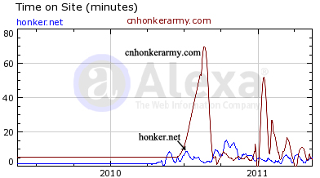
2010: Diaoyu Island Incident with Japan
Percentage of global Daily Reach which arrived at honker.net and cnhonkerarmy.com over the past 12 months
honker.net experienced much higher surge in reach due to appearance on news (see paper)
Average time spent on site on honker.net and cnhonkerarmy.com over the part 12 months
This shows that people do more than just merely becoming a member
Notes:
What does the change in dataset mean when we changed to examine Web traffic rather than membership
- so, we studied the time spent on site to see if people where engaging in the activities on the forum
cnhonkerarmy.com yes, honker.net no.
Time spent on a site demonstrates that the members do more than just register, time spent also indicates some degree of engagement. In lieu of interview or other direct research engagement, this is the best that can be achieved.
Membership, plus time spent, plus the showcasing of defaced websites all demonstrate a specific form of political activism based on the ressentiment and relative deprivation engendered by the patriotic education campaign and the limits placed on physical dissent.

Slide 14
Conclusion
A theoretical framework combining Relative Deprivation, Social Identity Theory, Nationalism and ressentiment fits
The lack of physical ways to express ressentiment and availability of the Web drives some people to hacktivism
Membership growth patterns of hacktivist forum supports the proposed framework

Slide 15
THANK YOU Craig Webber c.webber@soton.ac.uk my2e09@ecs.soton.ac.uk http://ecs.soton.ac.uk/people/my2e09 Twitter: @michael_yip

